Slide 1
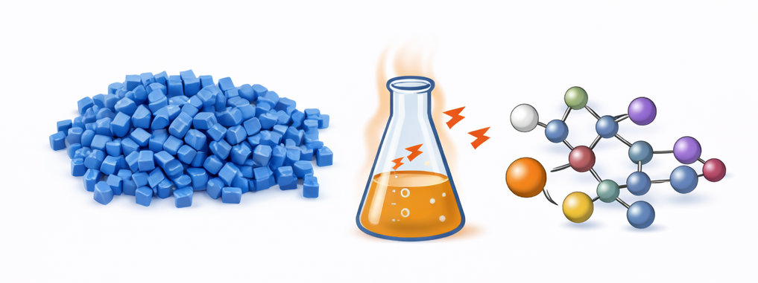

Modeling Heat Stabilizer Performance​ for Polymer Formulations
By: Kalyani Jaywant Khandait, Daniyar Abykhanov, Dylan Trott
Notes:
AI-generated image using DALL·E (OpenAI), 2026.

Slide 2
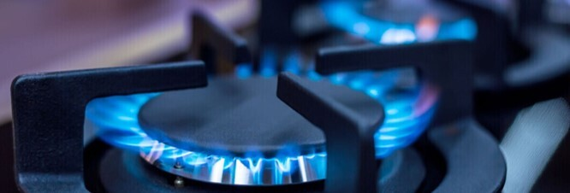


About Our Project
Arkema is a large-scale industrial chemical manufacturer
Our project is working with their thiochemicals department, which specializes in sulfur-based compounds
Arkema makes a variety of products such as odorizers for gases, chemicals to improve fertilizer, and additives to animal feed
Image Source: https://www.arkema.com/global/en/products/product-families/

Slide 3
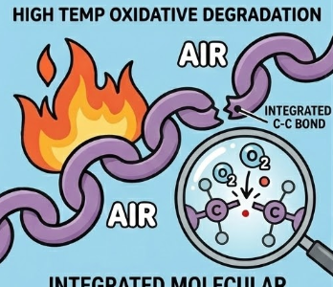

Problem Statement
Problem to address:
Polymers react spontaneously with oxygen at higher temperatures, creating destructive peroxyl radicals
To prevent oxygen degradation:
Use a radical scavenger to ‘quench’ the radicals before they degrade the product
The effectiveness of a radical scavenger depends on the kinetic rate constant k
Image generated using Google Gemini
Common antioxidant reaction pathway (X = S, O, N): Hydrogen Atom Transfer (HAT)

Slide 4
Project Goal
Project goal: Develop a model correlating experimental k values with material properties to inform Arkema's future antioxidant design
Changes in approach: No major changes. Our computational approach has remained consistent.
Unique Challenges: ​
Finding a balance between coarse and fine clustering

Slide 5
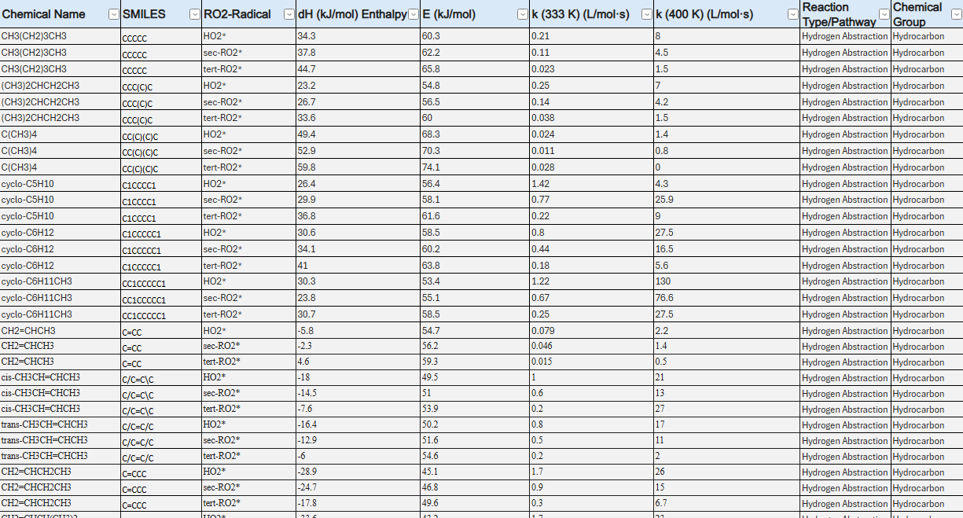
Experimental data for our project
Experimental Data Sources:
Handbook of Antioxidants: Bond Dissociation Energies, Rate Constants, Activation Energies, and Enthalpies of Reactions (1st ed.). E. Denisov. CRC Press. (1995)
Rate constants for reactions of peroxyl radicals in fluid solutions by Neta et al. Journal of Physical and Chemical Reference Data 19, 413 (1990)
Experimental Data
Data extracted from experimental papers on antioxidant reactivity
Gives us k values. Also tells us about enthalpy, activation energy
Details reactivity based on radical structure
Our data set with over 1500 rows of experimental data

Slide 6
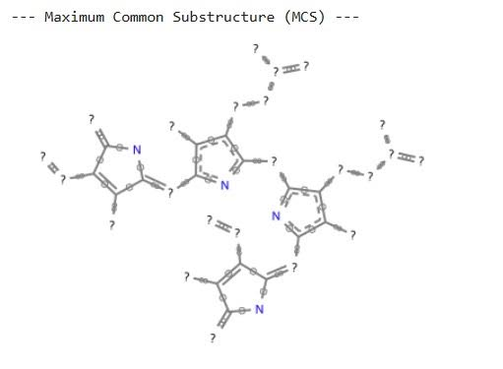
Molecular substructure data for our project
Morgan Fingerprints:
Generates topographical encodings of molecular structure
Correlates similarities between structures
Based on bit vectors → not interpretable
Bert / RdKit Descriptors:
Encodes chemical information such as molecular weight, hydrophobicity, # of H-bond donors
Describes structure-property relationships
Interpretable
Example output from our data set

Slide 7
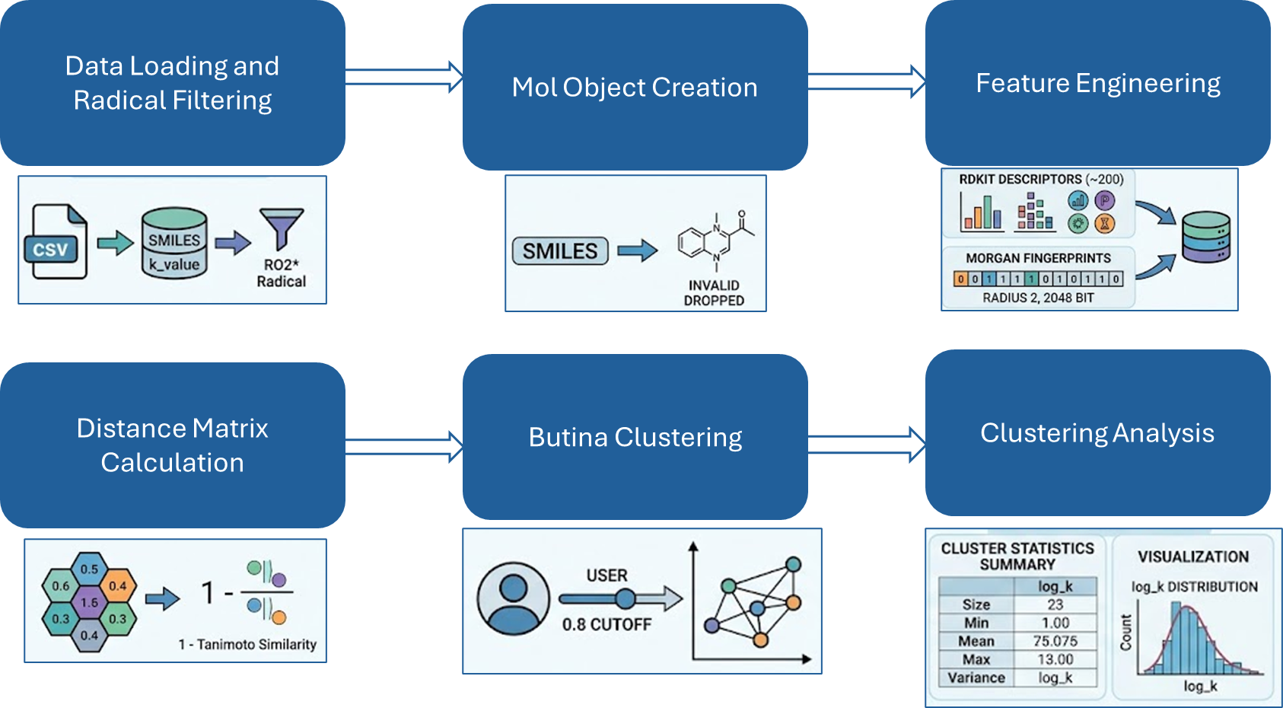
WorkFlow for our Clustering
Notes:
Kalyani

Slide 8
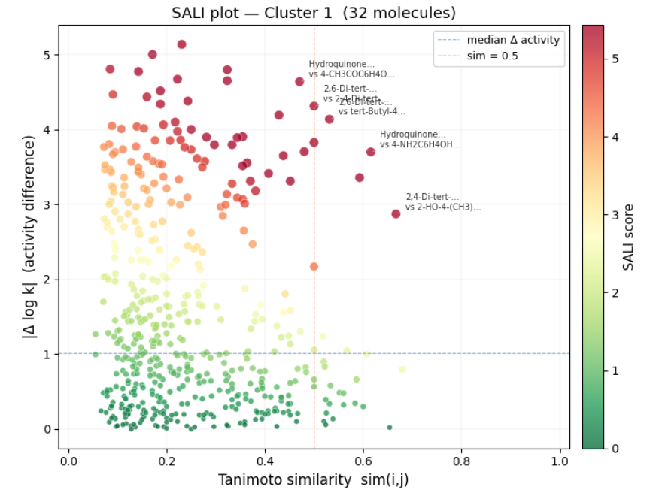
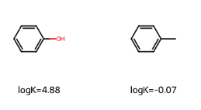
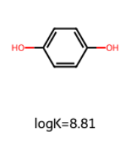
SALI (Structure-Activity Landscape Index) Plots
"How different is their radical reactivity"
Some molecular insights are apparent, such as the addition of –OH bonds to a benzene ring
"How similar is the molecular structure"
Notes:
Kalyani

Slide 9
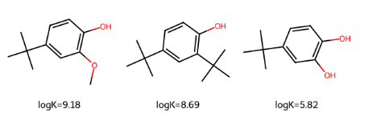
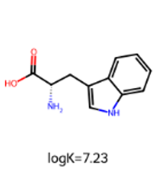
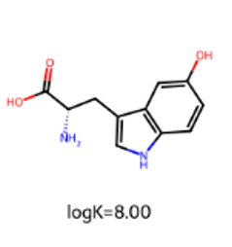
Impact of –OH bond position on antioxidant reactivity
More –OH bonds do not necessarily lead to greater radical scavenging
OH bond reactivity depends on electron donating ability of adjacent groups
Notes:
Kalyani

Slide 10
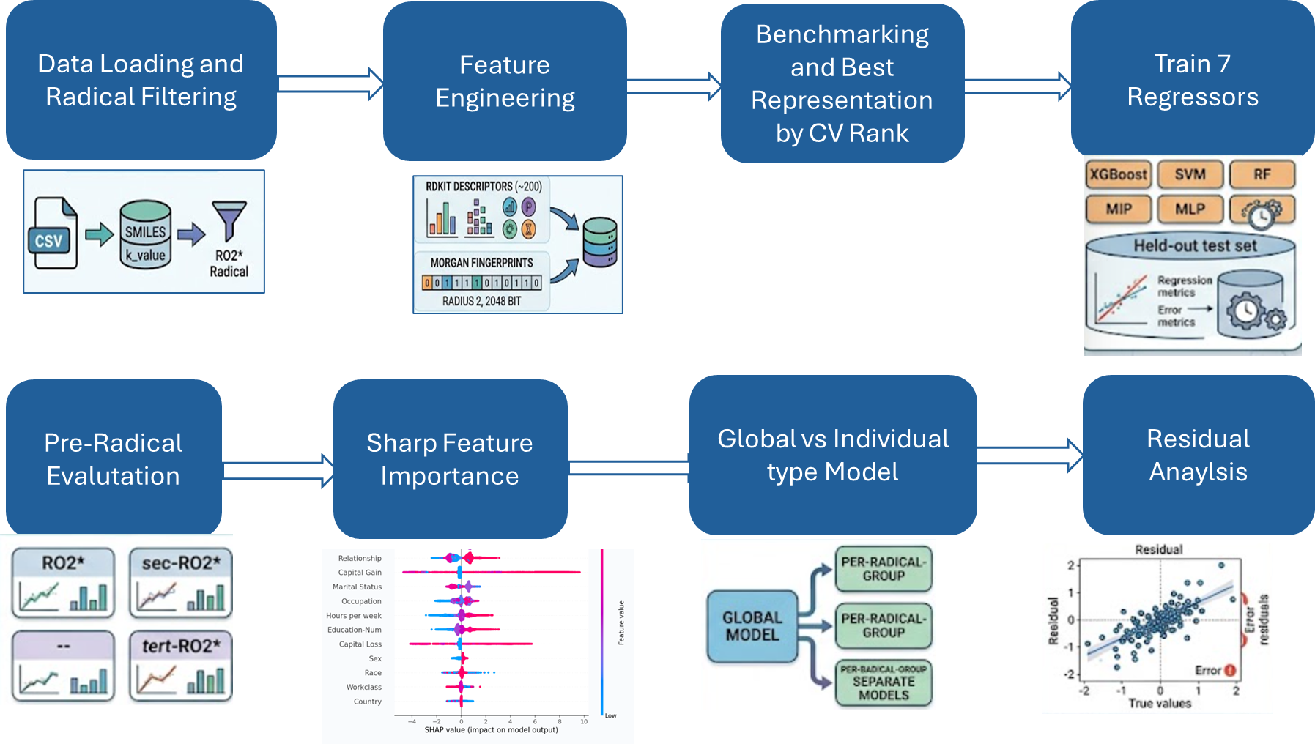
Model Workflow
Notes:
Danny

Slide 11
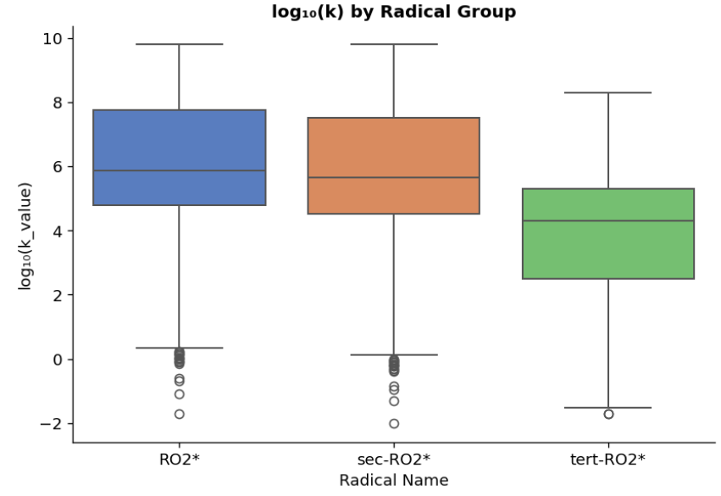
Reactivity of antioxidants depending on radical type
Tertiary RO2* has a longer life time but less reactivity due to increased stability from side groups
Notes:
Kalyani

Slide 12
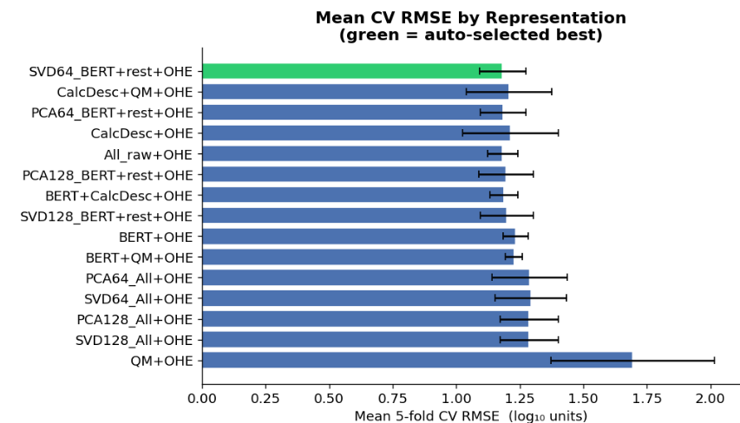
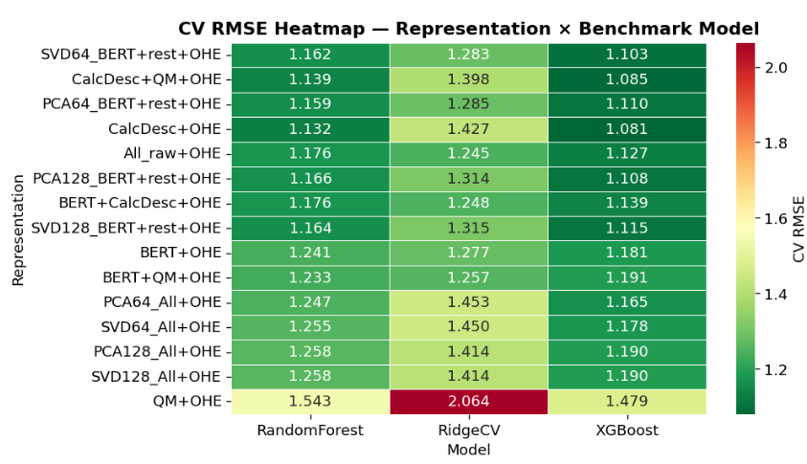
Model selection based on radical type
SVD64_BERT+rest+OHE combines compressed structural embeddings (BERT→SVD64) with complementary physicochemical (CalcDesc), electronic (QM) and mechanistic (OHE Radical) descriptors, achieving the best balance between expressiveness and generalization (mean CV RMSE = 1.162).
Notes:
Danny

Slide 13
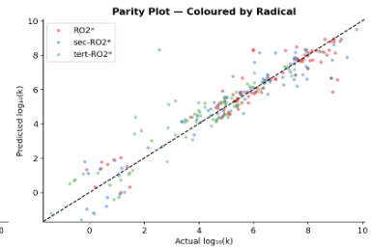

Predicting radical reactivity based on radical type
One global SVR model (SVD64_BERT+rest+OHE, Test R²=0.88) evaluated separately per radical group. The model generalizes consistently across all three radical types with R² > 0.83, confirming that encoding radical type as an OHE input feature is sufficient without training separate models per group.
Notes:
Danny

Slide 14
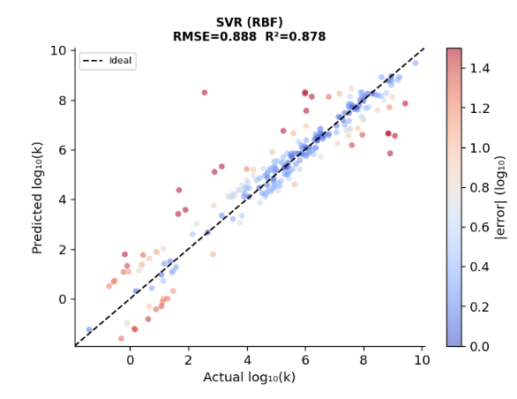
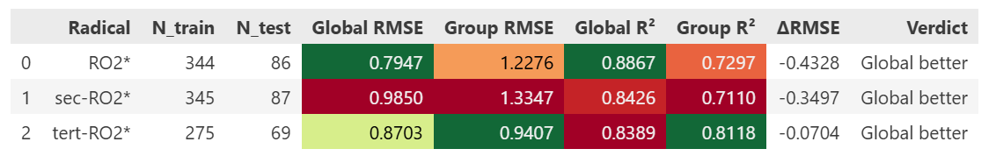
Modeling based on radical type
To predict reactivity of different of radicals types, we employed a global model and individual models to see which would perform best
To predict reactivity of different of radicals types, we employed a global model and individual models to see which would perform best
Individual models performed worse due to low sample size
Notes:
Danny

Slide 15
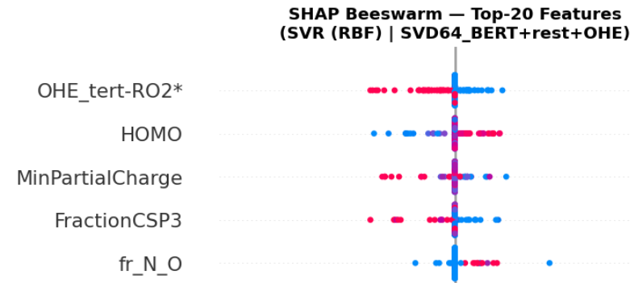
Impact of molecular features on antioxidant performance
Our model found that the following features most influenced antioxidant reactivity:
HOMO (highest occupied molecular orbital), minimum partial charge, fraction of sp3 carbons, and fraction of N/O
Lower amount of sp3 carbons results in greater reactivity
Red = high feature value
Blue = low feature value
Notes:
Dylan

Slide 16
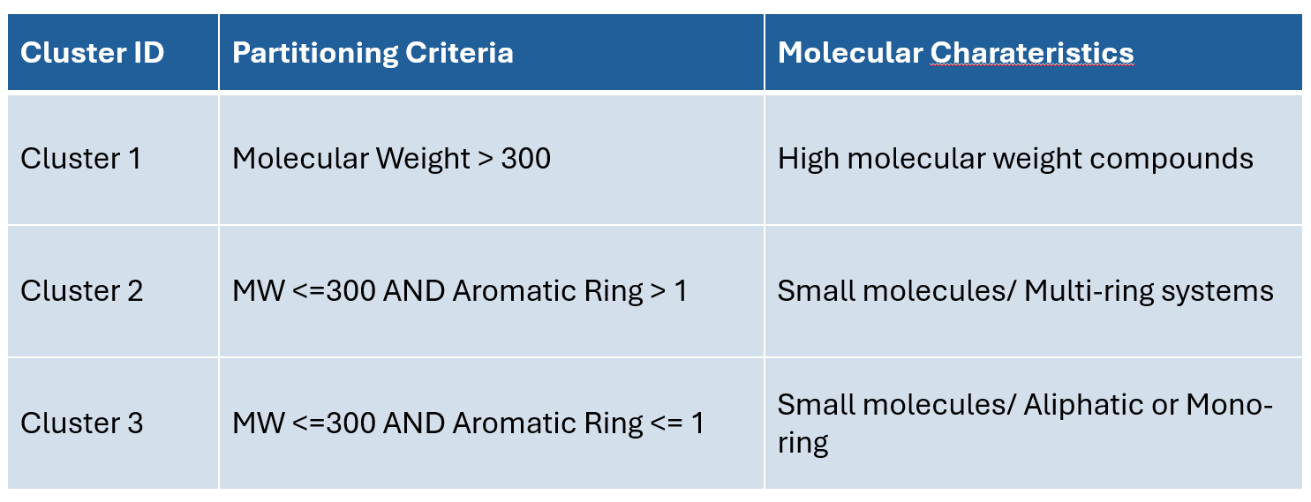
Cluster ID Split for the Model
Followed same workflow, but now instead of type of radical it's on these 3 divisions
Notes:
Kalyani

Slide 17
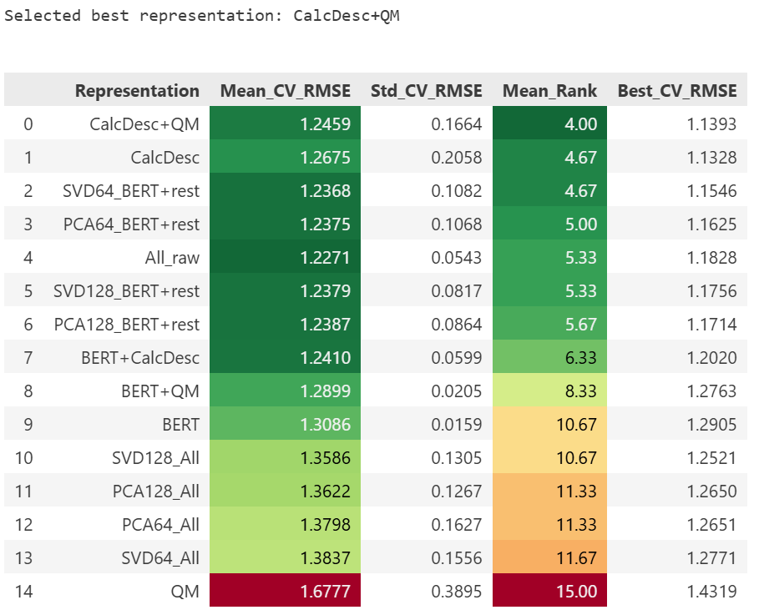
Comparison between model descriptions
CalcDesc+QM performed best for the cluster model because physicochemical descriptors (MW, LogP, TPSA) capture structural diversity between clusters
QM features (HOMO/LUMO/Gap) add electronic reactivity.
BERT embeddings provided no additional benefit since clusters were already defined by molecular similarity.
Notes:
Danny

Slide 18
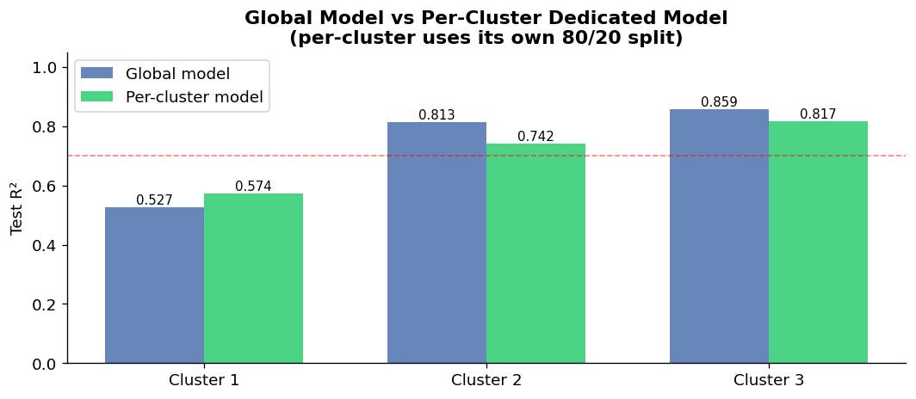
Training results on cluster-based modeling
Our model performs best on Clusters 2 and 3 (R² > 0.81), where the global model outperforms dedicated per-cluster models.
Cluster 1 is the most challenging (R²=0.53) due to limited training data (n=189) and higher structural variability - a dedicated SVR model provides a slight improvement (+0.047 R²).
Notes:
Danny

Slide 19
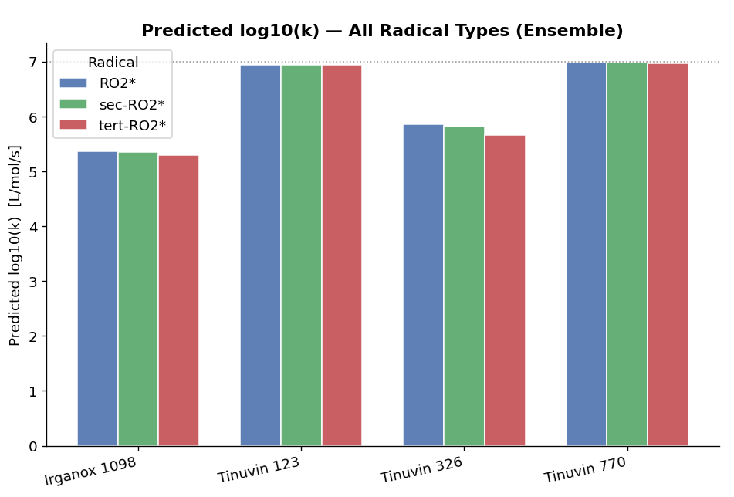
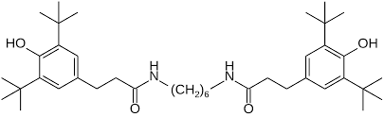
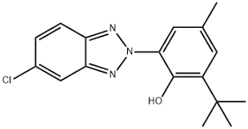
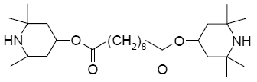
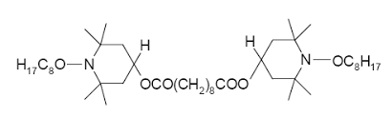
Predicting reactivity of commercial stabilizers
Irganox 1098
Tinuvin 326
Tinuvin 770
Tinuvin 123
Tinuvin 123 and 770 performed one standard deviation above average for our data set. Irganox 1098 reactivity was less significant.
Notes:
Dylan

Slide 20
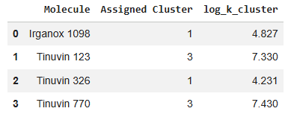
Differences in reactivity due to molecular weight
Irganox 1098 and Tinuvin 326 placed into separate cluster due to having a larger molecular weight, which explains their differences in predicted reactivity
We believe our model is less effective at predicting the reactivity of antioxidants with larger molecular weights due to the nature of our data set
Notes:
Dylan

Slide 21
Model Limitations
Due to limitations in the data set, our model didn't include features which are known to impact radical scavenging:
pH
Temperature
Solvent
Not fine tuning the models
Our data set had lower kinetic rate k for larger molecular weight molecules, which led to lower predictions for molecules with a large molecular weight
Does not provide one universal solution
Notes:
Kalyani

Slide 22
Conclusions
One model for radical type gives better results. For models compared based on molecular weight and aromatic Rings. One single model does not generalize as well on molecules with higher molecular weight.
We observed an R² correlation for RO2* radicals at 0.88, sec-RO2* at 0.84, and tert-RO2* at 0.84.
​
Highest unoccupied orbital (HOMO) level and fraction of N and O were the most positively correlated, while a lower minimum partial charge and lower fraction of sp3 carbons had the strongest negative correlatation to antioxidant reactivity
-OH bonds positively contribute to antioxidant reactivity, unless they are positioned such that they reduce the electron density of nearby H-donors
Notes:
Kalyani

Slide 23
Conclusion – Key lessons
Technical lessons learned:
Clustering can only be as effective as your data set allows
Prioritize mechanistic features. If you know the underlying physics of the problem (e.g., electron transfer), engineering features that represent those physics will result in a more robust model than relying on brute-force structural counts.
Parts of our goal we did not accomplish:
- Didn't incorporate temperature dependence into our model
- Data didn't allow for a specific understanding of reactivity based on radical type
Notes:
Kalyani

Slide 24
Contributions (CRediT)
Dylan:
- Conceptualization, validation, project administration, supervision,
Kalyani:
- Data curation, formal analysis, software, visualization, investigation, project administration
Danny:
- Formal analysis, methodology, software, validation, resources
All: ​
- Writing – original draft, review, and editing, conceptualization, formal analysis
Notes:
Kalyani

Slide 25

Questions?

Slide 26
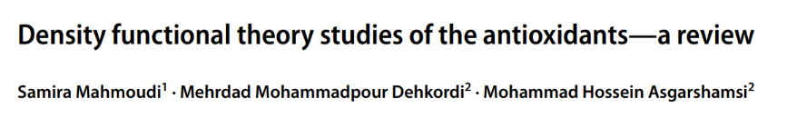
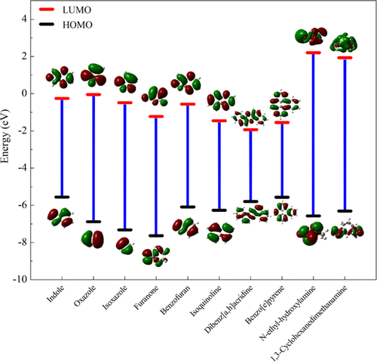
Adding to Data Features with DFT Descriptors​
Remember This Paper...
We know DFT Descriptors can be valuable but expensive to compute. Instead, we will use an existing ML Model.

Slide 27
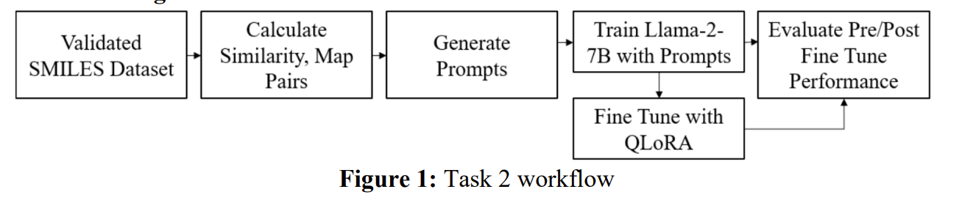
Model for DFT Descriptor
​
By coincidence, it happens the Dupont Spring 2024 hackathon group had a project on exactly what we needed!​
LARGE LANGUAGE MODELS FOR MOLECULAR DESIGN
https://github.com/NRT-hackathon/2024-DuPont
https://bpb-us-2.wpmucdn.com/sites.udel.edu/dist/d/12003/files/2025/02/DuPont.pdf

Slide 28
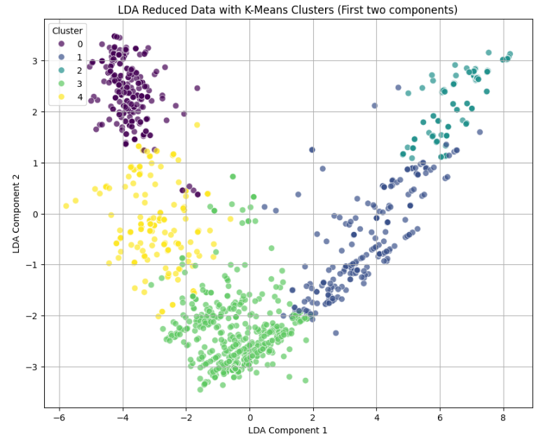
First Result
Visual clusters in 2D serve as a guide, but the not definitive
So, for now decided to SKIP the Reduction and see the results

Slide 29

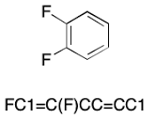
Data Acquisition Approach
Two main groups of data:
Rate constant k is not an intrinsic material property. Instead, the precise value depends on chemical structure and experimental conditions.
Experimental data from literature
Molecular information from Morgan Fingerprint and Birt/RDKit descriptors
SMILES String
Apodaca, R. L. Writing Aromatic SMILES. http://depth-first.com/articles/2021/06/30/writing-aromatic-smiles/ (accessed 2026-04-13).
Icons generated using google gemini

Slide 30
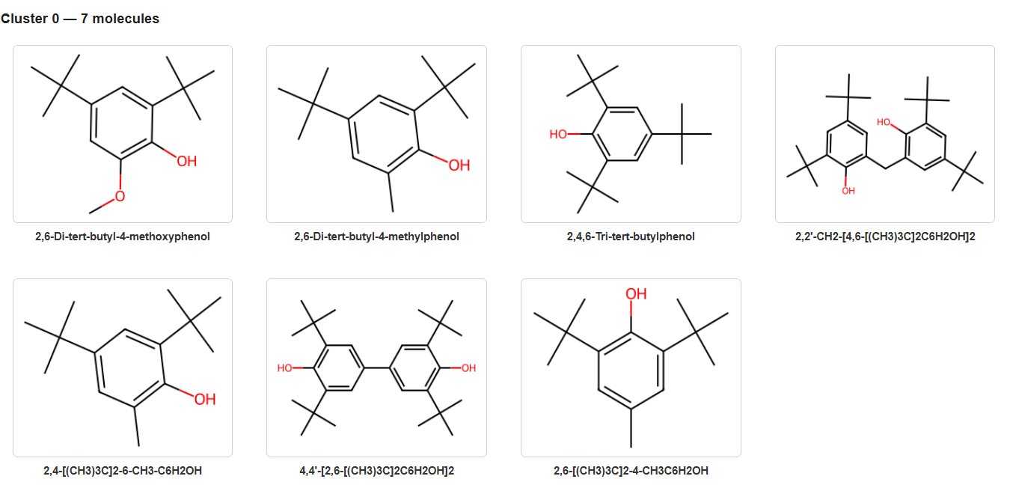
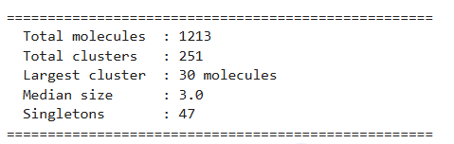
Substructure Revealed Within a cluster without Reduction
Now the algorithm successfully groups molecules with near-identical core frameworks.
The results show a perfect grouping of hindered phenols, specifically those with tert-butyl groups in the ortho positions.

Slide 31
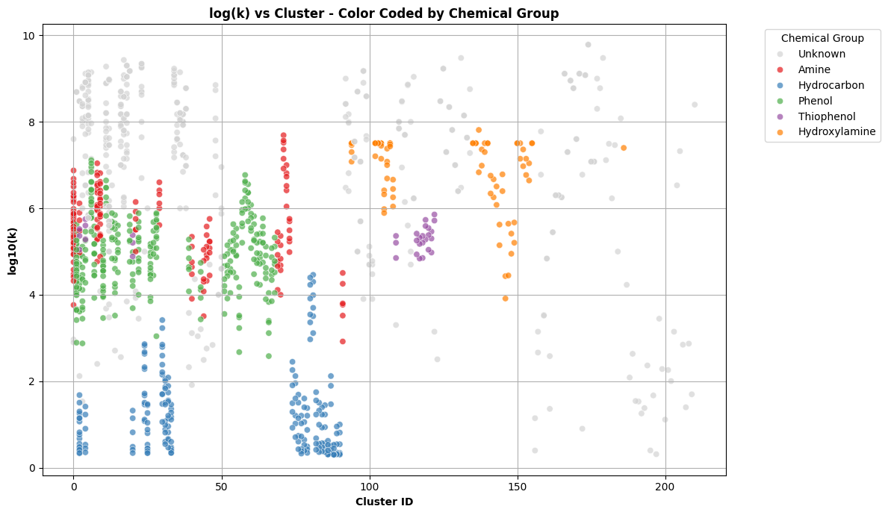
Reaction Rates Across Chemical Groups
Hydrocarbons consistently have the lowest reaction rates.
The data clusters (along the x-axis) are not neatly organized.
Many include mixtures of Amines and Phenols, showing that these two groups are more similar to each other than to the distinct groups like Thiophenol or Hydrocarbon.

Slide 32
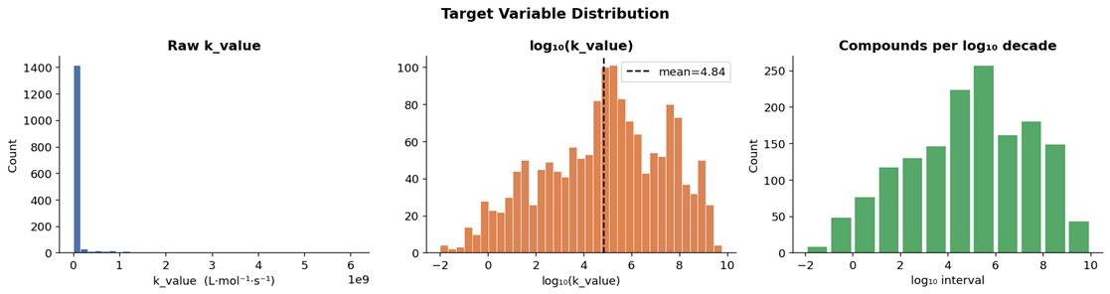
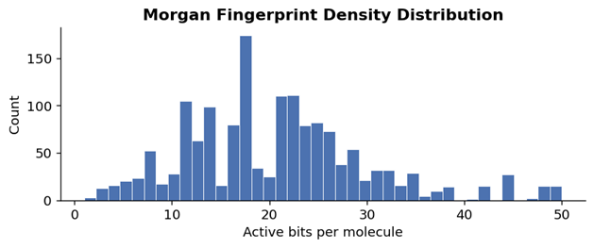
Initial Model Building
Cleaned dataset: 1,548 RO2• reaction entries (340 unique SMILES).
Target: predict log10(k), which stabilizes a target spanning >11 orders of magnitude.
Features: 2048-bit Morgan fingerprints (ECFP4) plus predicted HOMO, LUMO, and HOMO–LUMO gap.
Split: 80/20 train–test; all model selection was done on the training set only.
Log-transform makes the target much more model-friendly, while Morgan fingerprints remain sparse.

Slide 33
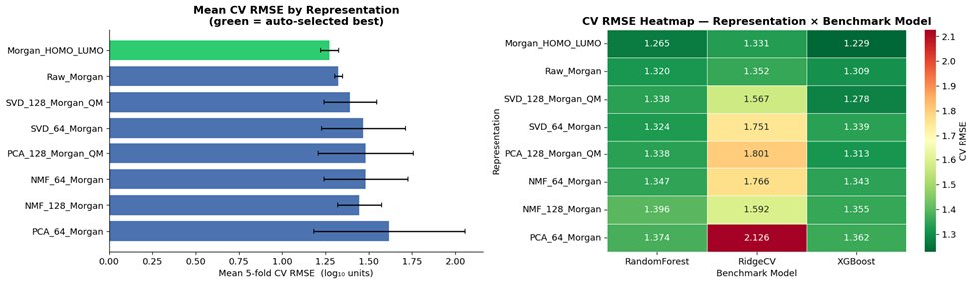
Representation Benchmark
Compared rawMorgan,Morgan + QM,SVD, PCA, and NMFrepresentations.
Benchmarked with 5-fold CVusing RidgeCV, RandomForest, and XGBoost.
Best representation: Morgan_HOMO_LUMO (mean CVRMSE = 1.265).
Adding HOMO/LUMO descriptors improved CV performance over raw Morgan alone.

Slide 34

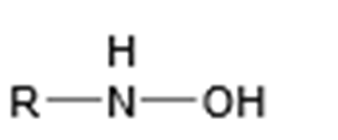
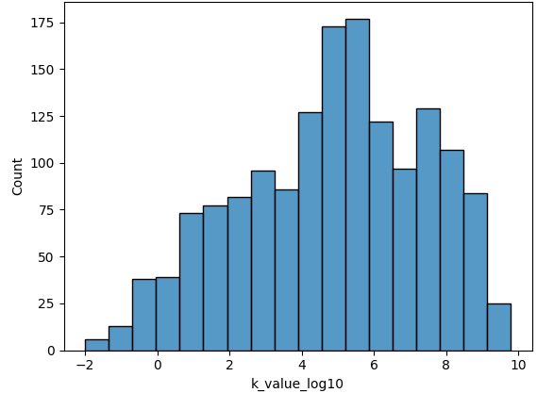
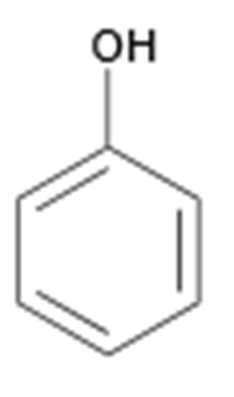
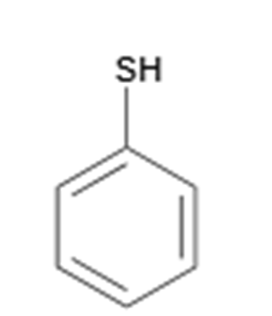
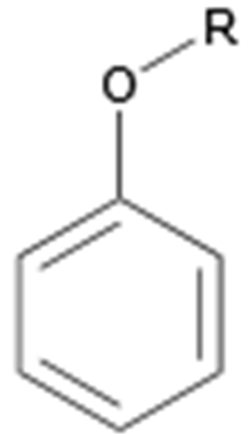
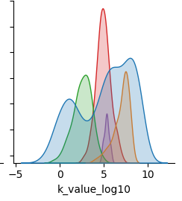
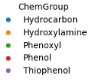
Data visualization of experimental data
Count
Key takeaway: Our data set has a broad range of k values, which is important to understanding influence of structure on k

Slide 35
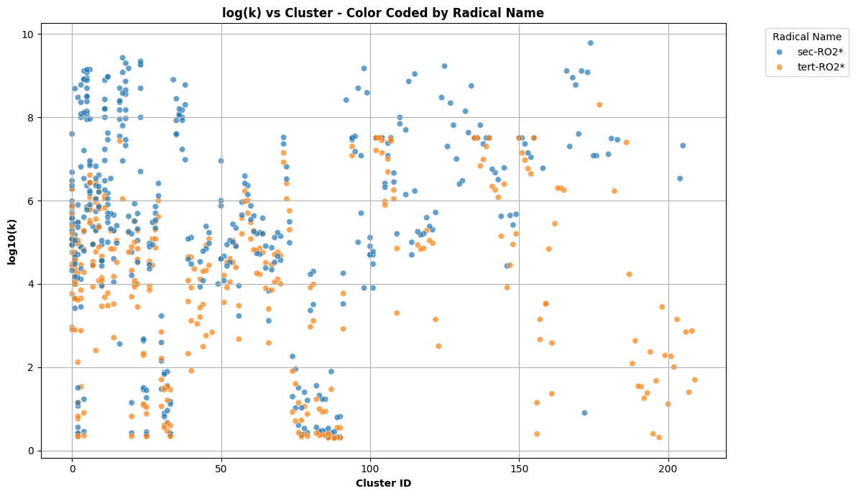
Clustering results on RO2 Radical Type
Secondary radicals (blue) generally exhibit higher reaction rates (log_k) across the majority of clusters compared to tertiary radicals (yellow).
Sec-RO2* has greater intrinsic reactivity since it is less stable than tert-RO2*
Reaction Rates of Secondary vs. Tertiary for RO2* Radicals​

Slide 36
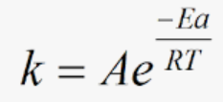
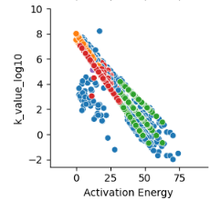



Data Visualization of Experimental data
Activation Energy (kJ/mol)
Count

Slide 37

Final Model Comparison
• LightGBM achieved the best held-out test performance.
• Test RMSE = 1.204, MAE = 0.934, R² = 0.788.
Random Forest and XGBoost were close behind.
Key takeaway: Tree-based models outperformed linear and distance-based baselines.

Slide 38

Feature Importance / Preliminary Takeaways
The strongest predictors are LUMO, HOMO, and the HOMO–LUMO gap.
A small set of fingerprint bits adds complementary structural information.
The best model depends on both electronic and molecular-structure features.
QM descriptors drive most of the predictive signal in the best LightGBM model.

